Slide 1
Threat Prioritization – Candidate Ranking
AVCDL-Foundation-9.1.1
Charles Wilson
Staff Product Cybersecurity Architect
version 4
2026-07-10
Notes:
Script:
I'm Charles Wilson, staff product cybersecurity architect at Torc Robotics.
This presentation will cover the Threat Prioritization Candidate Ranking activity.

Slide 2
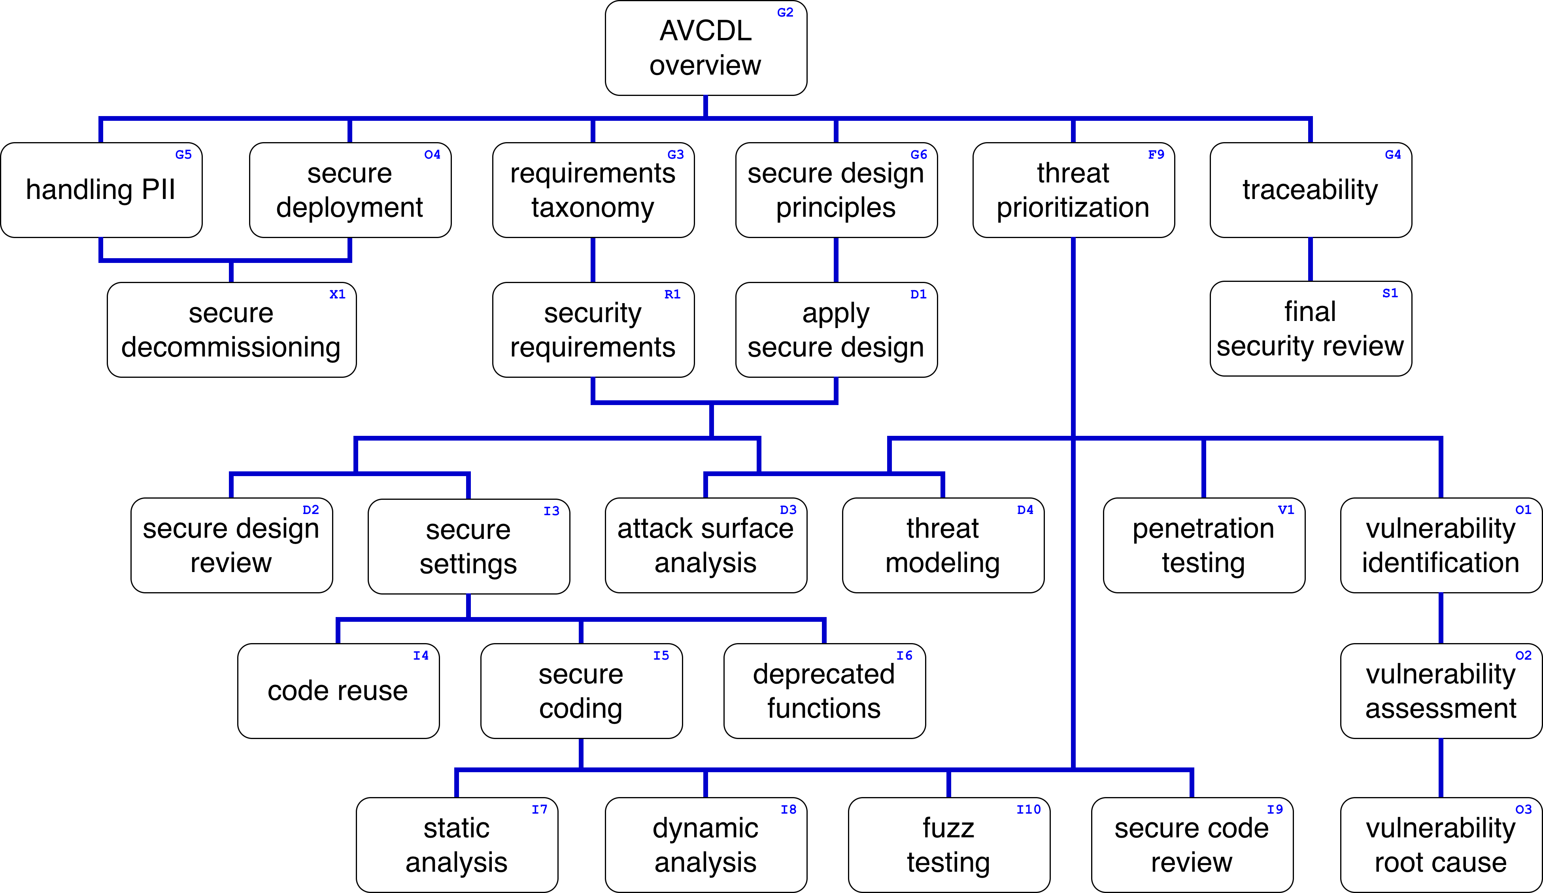
Training Path
Notes:
Script:
This diagram shows the overall AVCDL training path.
If you're taking this training, it's assumed that you've already completed
[pause]
the AVCDL Overview training.
And additionally, that you've completed
[pause]
the Threat Prioritization Overview training.
This training covers the Threat Prioritization - Candidate Ranking activity.

Slide 3
Workflow
Notes:
Script:
Before getting into threat candidate ranking, let's briefly review where it fits in the overall threat prioritization process.

Slide 4
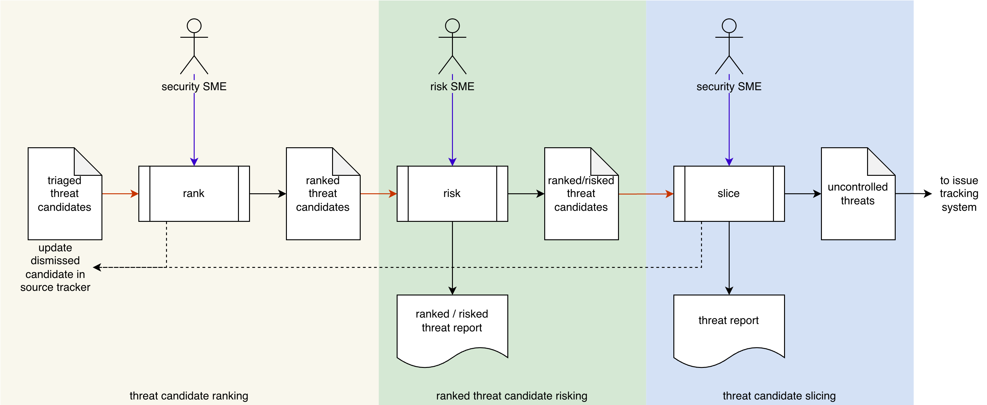
Process Workflow
Notes:
Script:
Here's the threat prioritization process which we previously covered in the Threat Prioritization Overview training.
[break]
Our focus for this training will be on the first activity, that of threat candidate ranking.

Slide 5
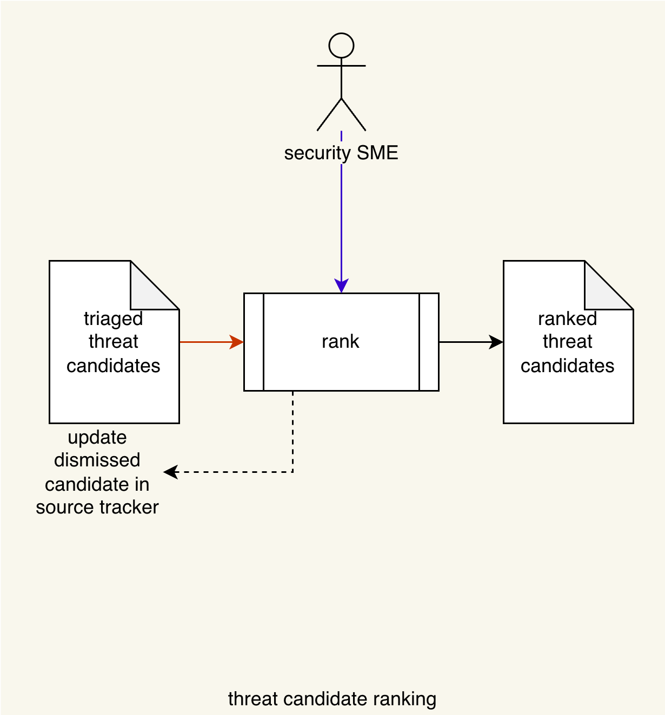
Process Workflow
Notes:
Script:
Here's the threat prioritization process which we previously covered in the Threat Prioritization Overview training.
[break]
Our focus for this training will be on the first activity, that of threat candidate ranking.

Slide 6
Candidate Ranking Activity
Likelihood
Worst case
Notes:
Script:
In the threat candidate ranking activity,
[pause]
the security SME takes
[pause]
the triage threat candidates
[pause]
and conducts a ranking on them, producing
[pause]
a list of ranked threat candidates.
[pause]
Any candidates which are determined to be invalid are dismissed, and their source tracker is updated accordingly.
[pause]
Threat candidate ranking entails evaluating each threat candidate and determining
[pause]
its likelihood.
Additionally,
[pause]
a worst case scenario is provided for each.
[pause]
Let's start by considering what a likelihood is.

Slide 7
Likelihood Rubrics
Common Vulnerability Scoring System
Common Configuration Scoring System
Common Misuse Scoring System
NIST SP 800-30 Tables G-2 through 5
Notes:
Script:
When we talk about likelihood, we're referring to whether or not an event is going to occur.
In the context of cybersecurity threats, this is whether the threat can be realized.
[pause]
When we talk about likelihood rubrics, we're referring to the method used to determine what that likelihood is.
The actual mechanism varies greatly.
Probably the most well-known likelihood rubric is
[pause]
the common vulnerability scoring system (CVSS).
This rubric focuses on defects in the construction of the system.
This rubric is seen all over the place.
Most notably, when a cybersecurity incident is reported, a CVSS score will be assigned to it.
That score is given a lot of weight when it comes to how we perceive the identified threat.
[pause]
There are two related scoring systems that we should consider.
One is
[pause]
the common configuration scoring system (CCSS).
This rubric focuses on the mechanisms that are used to configure a system.
Whereas CVSS looks at the system and says, “this wasn't built right,” CCSS looks at the system and says, “the system is built right, but the way that you have configured it makes it subject to exploit.”
As an example, let’s consider a system using cryptography.
If you implement cryptography incorrectly, that will be reflected in the CVSS score.
If you implement cryptography correctly, but configure it improperly, that will be reflected in the CCSS score.
Improperly configured cryptography includes things like using the null password, or having a system which allows variable strength encryption, but uses a very weak version when a stronger one is available.
The other related scoring system is
[pause]
the common misuse scoring system (CMSS).
Here you have a correctly implemented system which is configured properly, but it's being applied in a way which is not its intended use case, and because of that, it allows a threat actor to take advantage of the system.
A classic example is an email application which allows embedded HTML content.
These three rubrics are all very similar in the way in which they make their determinations.
They all compute a numeric score and an associated quantized rating.
[pause]
A different approach is that used in a rubric developed by NIST and documented in
[pause]
SP 800-30, specifically in tables G 2 through 5,
This rubric uses a much more simplified mechanism to make it’s determinations.
It works entirely in a quantized rating space.
[pause]
To understand these differences, let's dig into likelihood quantization.

Slide 8
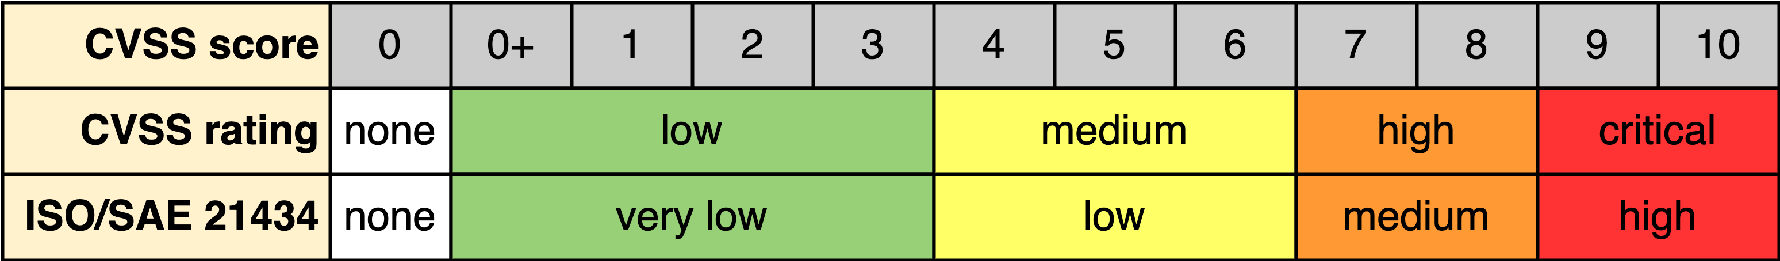
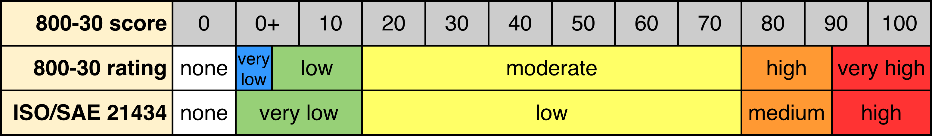
Likelihood Quantization
Notes:
Script:
First, let's consider what information the rubrics give us.
CVSS and its related rubrics
[pause]
generate a score.
This score has a value
[pause]
between 0 and 10 in increments of 0.1.
Contrary to popular belief, this score is not a scaled probability.
It’s a stack rank score.
If you review the CVSS documentation, you'll see how the score is generated.
The next part is where quantization comes into play.
Quantization is simply the mapping of high-resolution information to a lower-resolution representation.
With CVSS, most of the time we tend not to focus on the score but rather on the quantization of the score.
CVSS calls its quantization
[pause]
a rating.
The quantization values used by CVSS are
• low
• medium
• high
and
• critical
You can see here how these correspond to ranges of the score.
[pause]
Additionally, some domains will have a requirement for how they wish to have the likelihood quantized.
In the case of the automotive domain, specifically when dealing with
[pause]
ISO/SAE 21434, quantizations are specified as,
• very low
• low
• medium
and
• high
However, no particular numeric ranges are specified for these.
So here, we're just mapping them directly onto the CVSS specified ranges.
[pause]
Now, let's consider the NIST SP 800-30 rubric
It also has a
[pause]
score and
[pause]
rating, but it's built slightly differently.
Rather than deriving a rating from the score, 800-30 provides rating values of
• very low
• low
• moderate
• high
and
• very high
and provides
[pause]
associated ranges (between 0 and 100) for each, as we can see here.
We can create a domain mapping from
[pause]
ISO/SAE 21434 to 800-30 as follows:
We map
very low, to include both the very low and low,
[pause]
and low, medium, and high to moderate, high, and very high.
[pause]
In order to aid process automation, we're going to augment these values to include
[pause]
a quantization value of none representing a score of zero, because in practice you want to be able to determine whether or not a value has actually been set.
[pause]
Additionally, as you can see, the quantizations used by CVSS and 800-30 are very different.
The rating ranges for CVSS are biased toward the lower end of the scale, like a chi-square distribution, whereas with the 800-30, it looks more like a normal distribution, biased toward the middle of the scale.
Because of this, they can’t be compared apples-to-apples.
This is something that you need to deal with within a supply chain or even within an organization, where multiple rubrics are being used.
As mentioned earlier, within incident response, we tend to be dealing with CVSS scores.
However, in other activities, such as attack surface analysis and threat modeling, an organization may be using the 800-30 rubric.
Since these quantizations don't equate, if you have an incident response issue that comes in that impacts something that has also been threat modeled, you need to take extra care in handling the quantized ratings being passed around.
Now, let's dig a bit deeper into 800-30, because unlike CVSS where you just take the threat candidate and score it, with 800-30, there's a bit more involved.

Slide 9
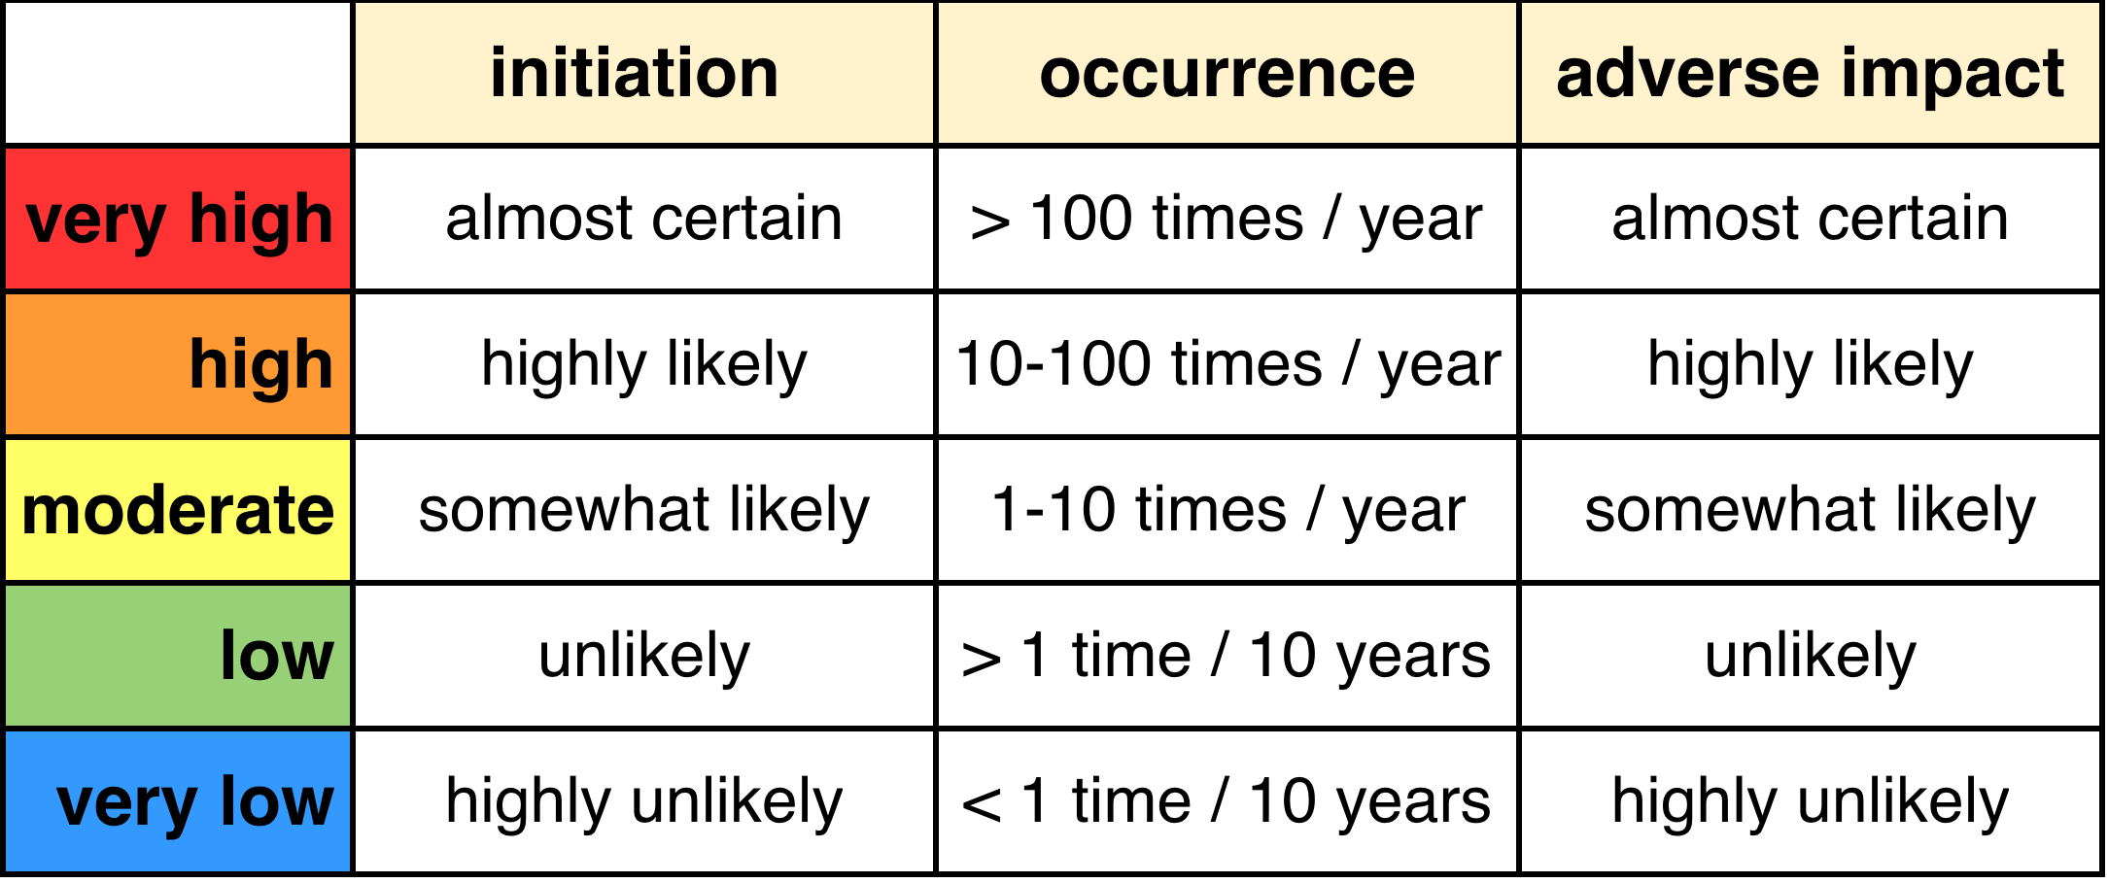
800-30 Likelihood Descriptions
Notes:
Script:
The NIST 800-30 likelihood rubric specifies the ranges for quantization, but in practice, it doesn't actually use that information.
It operates exclusively in the quantized space.
Let's look at how this rubric is applied.
We’ll start by listing the quantization values.
They’ll be in reverse order because that's what 800-30 does.
We have
• very high
• high
• moderate
• low
and
• very low
There are three distinct applications of these.
The first two deal with the threat itself but differ by the source of the threat.
The first of these is
[pause]
the likelihood of initiation.
Can the threat be realized by an adversary?
The criterion for each value is as follows:
• very high means that it's almost certain
• high means that it's highly likely
• moderate means that it's somewhat likely
• low means that it's unlikely
and
• very low means that it's highly unlikely
Now, this may seem like a subjective measurement, and it absolutely is.
As an organization you need to agree upon what these mean in practice.
And so, when we're performing a threat ranking using 800-30 and are considering an adversarial approach, it's important to document why a particular rating is chosen.
On the other side, we have
[pause]
the likelihood of occurrence.
These are non-adversarial in nature.
The threat is not attack-related, but rather one arising intrinsically.
Here we have something that we can measure or at least estimate.
• very high is more than 100 times a year
• high is between 10 and 100 times a year
• moderate is between 1 and 10 times a year
• low is more than once every 10 years
and
• very low is less than once every 10 years.
Here we have a much more concrete way to determine what the likelihood should be.
One would think that between these two scenarios, that we have everything covered, but 800-30 brings in a third element, an estimation of whether there will be an adverse impact.
This is not the severity of the impact, but rather
[pause]
the likelihood of any adverse impact.
Here we see that we use descriptions of
• almost certain
• highly likely
• somewhat likely
• unlikely
and
• highly unlikely
which are the same as those used for the adversarial initiation scenario.
[pause]
This is interesting.
We have three components, but what do we do with them?
We’ll look at that next.

Slide 10
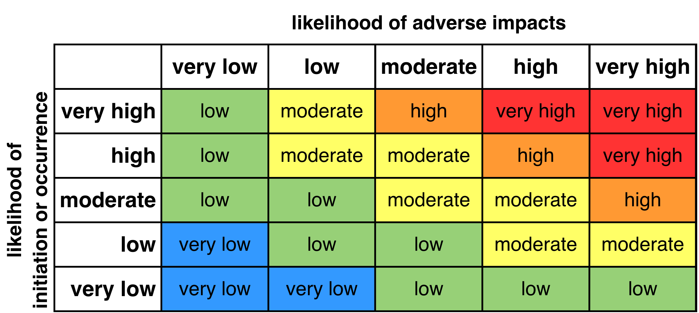
800-30 Overall Likelihood
Notes:
Script:
What 800-30 does that's interesting, is create an overall likelihood.
It does this by taking one of the first two components that we talked about,
[pause]
either the likelihood of initiation or of occurrence, depending on whether you're talking about an adversarial or non-adversarial scenario, and it composes that with
[pause]
the likelihood that there'll be an adverse impact.
[pause]
We can visualize that as we see here.
All one does is to take the likelihood of initiation or occurrence value from
[pause]
the left side, the likelihood of adverse impact value from
[pause]
the top, and then find
[pause]
where they intersect.
This is the overall likelihood of the threat.
This provides us a more expressive likelihood, even though we're using a coarse-grained rubric to make that determination.

Slide 11
Example
Notes:
Script:
Now let's work our way through an example to illustrate how threat candidate ranking is performed.
We're going to use the triage output from a threat modeling exercise.
Additionally, we're going to apply both a CVSS-based approach and an SP 800-30 one, so that we can compare and contrast them.

Slide 12
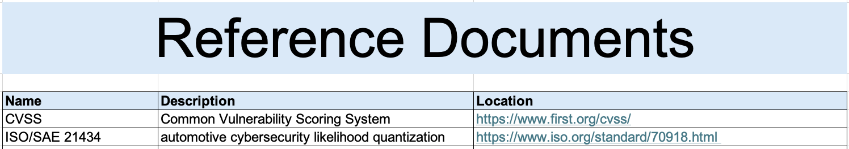
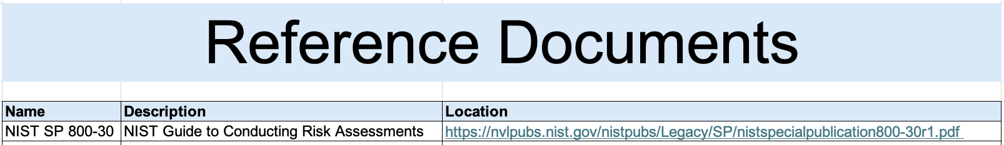
Reference Documents
CVSS
800-30
Notes:
Script:
As with completing any instantiated AVCDL template, we're going to start out, aside from filling in the cover sheet, by providing our reference documents that we're going to be using.
[pause]
For the CVSS case, we're going to always have these two references, one is
[pause]
for CVSS itself, and because we're going to also look at domain quantization, we're going to include a reference
[pause]
for ISO/SAE 21434.
[pause]
In the case of NIST SP 800-30, we're going to have
[pause]
the NIST 800-30 documentation reference.
We're using two different templates here because the one we use for CVSS is based on the general template and will require tailoring, whereas the one for SP 800-30 is specific to that rubric and has a whole bunch of stuff that has been hardcoded in it.
Let’s start with CVSS.

Slide 13
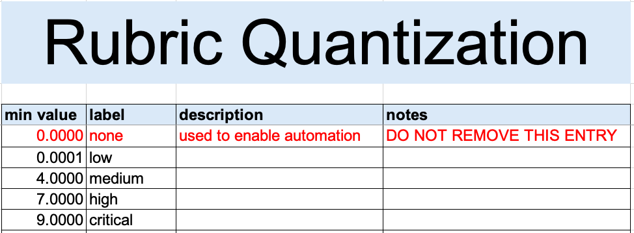
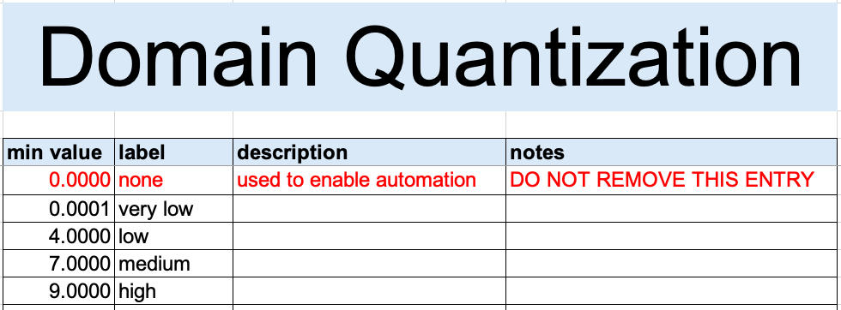
CVSS Quantization Mapping
Notes:
Script:
Before we can use any rubric that generates a score in the way that CVSS does, we need to create a mapping in the workbook from
[pause]
the rubric score to
[pause]
a set of quantization values.
For CVSS that's fairly simple, and we show that here in
[pause]
the rubric quantization.
As mentioned, we're including
[pause]
a none and that entry is provided in the template.
We then provide the minimum value for each of the quantization ranges.
That's what we're seeing here in this table.
We have
• low starts slightly above zero
• medium starts at 4
• high starts at 7
and
• critical starts at 9
What will happen in the ranking sheet is that when a value is entered for the CVSS score, the corresponding quantized value will be automatically populated.
Next, we're going to do the same exercise for
[pause]
the domain quantization.
As you can see here, the only distinction is that the labels are different.

Slide 14
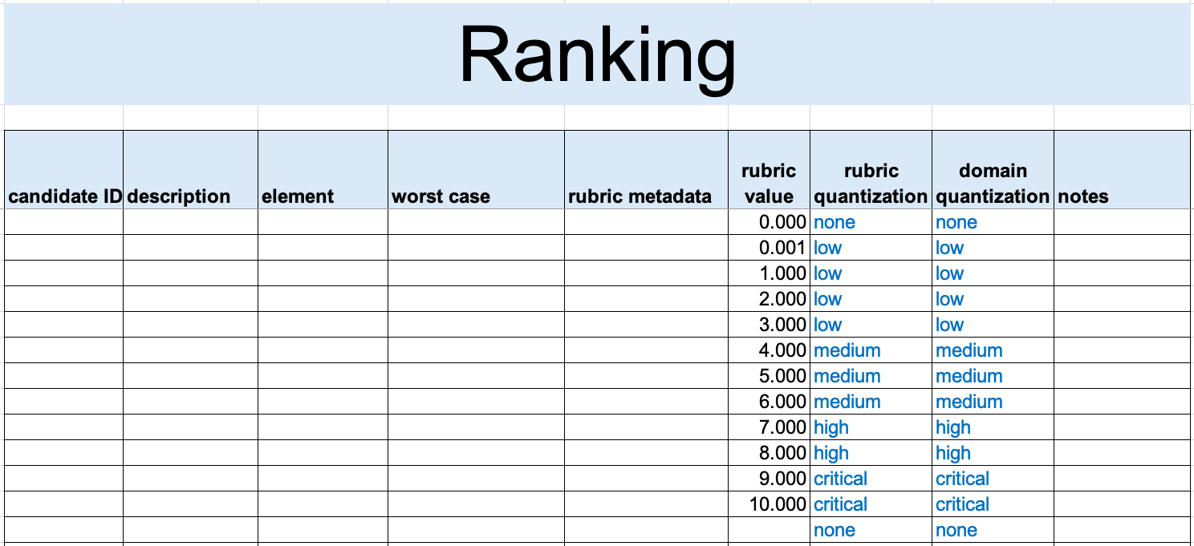
CVSS Quantization Mapping Sample
Notes:
Script:
Here for illustration purposes, we can see how the quantization mapping will take place in the ranking sheet.
When we enter
[pause]
a value for the rubric, the sheet automatically populates the two quantization columns, one corresponding to
[pause]
the rubric and the other to
[pause]
the domain, if one is used.
We can also see that if no value is entered, then conveniently the rubric and domain values map
[pause]
to none.

Slide 15
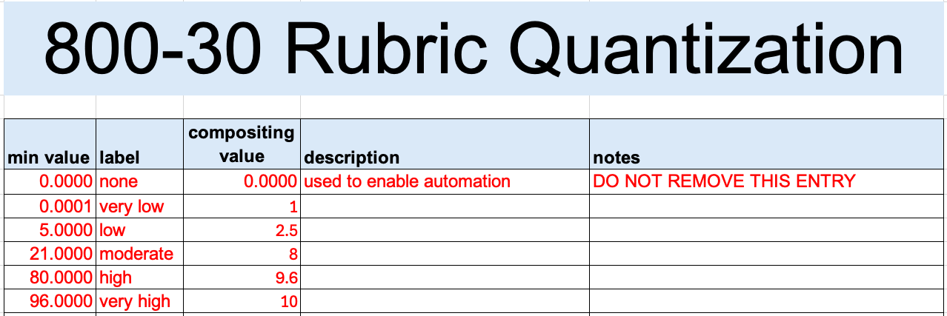
800-30 Quantization Mapping
Notes:
Script:
In the case of SP 800-30’s quantization, let's again consider
[pause]
the score and
[pause]
the rating where we show the ranges.
Because we're dealing in a rubric that works off its quantization, what we've done is provide
[pause]
the mapping for
[pause]
the quantization minimum value and label in the template itself.
Also provided is
[pause]
the set of values needed to calculate the overall likelihood.
The nice thing about this is you don't need to do any work if you're going to use the 800-30 rubric, the template takes care of all of that.

Slide 16
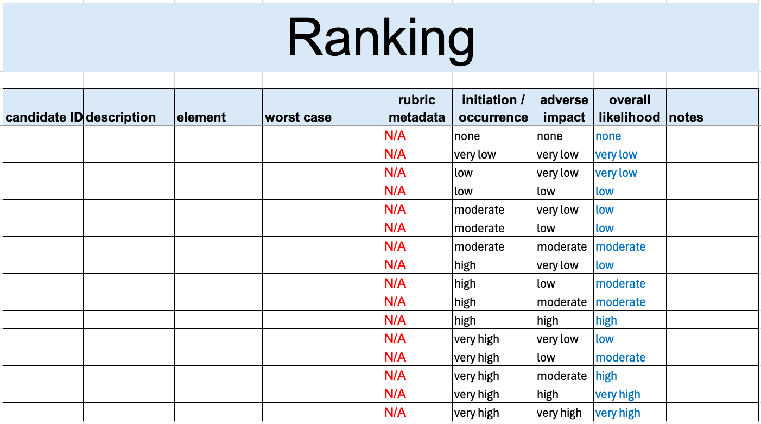
800-30 Quantization Mapping Sample
Notes:
Script:
And here's a sample of what the SP 800-30 quantization looks like for various values of
[pause]
the initiation / occurrence, and
[pause]
the adverse impact.
And we can see the light blue showing us
[pause]
the overall likelihood.
For example, if we have an initiation or occurrence of
[pause]
very high and an adverse impact of
[pause]
low, the overall impact will be
[pause]
moderate.
Which is exactly what we see in
[pause]
the table.

Slide 17
800-30 Quantization Mapping Sample (Overlay)
Notes:
Overlay

Slide 18
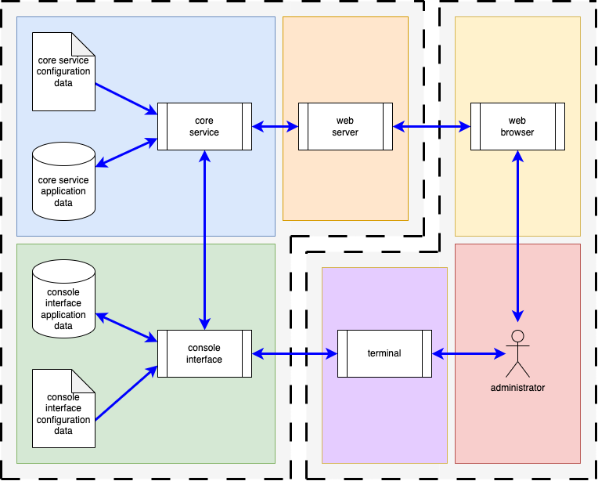
Example System
Notes:
Script:
Now, let's turn our attention to the system we'll use for this example, and in fact, as our example throughout the various AVCDL activities we explore.
It is intended to be able to be used in any domain, be quickly grasped, and not be overly complicated.
[pause]
On the right, you'll see that we have an interactor.
This is an administrator using two modalities to interact with the system, a web browser and a terminal.
[pause]
On the left, in the system of interest, we have a web server and a console interface that the administrator is interacting with.
Both are communicating with a core service.
The core service and console interface have configuration and application data.
The system has multiple processes, read-only and read-write data stores, and multiple types of data flows.
For all practical purposes, this system contains everything needed to examine a wide variety of cybersecurity concepts and activities.
What we're going to do is look at the outcome of a threat modeling activity applied to this system.
The details of the threat modeling process aren’t important to our discussions here.
We will, however, need to cover a few aspects to motivate how we got the input we’ll be using for the threat candidate ranking activity itself.

Slide 19
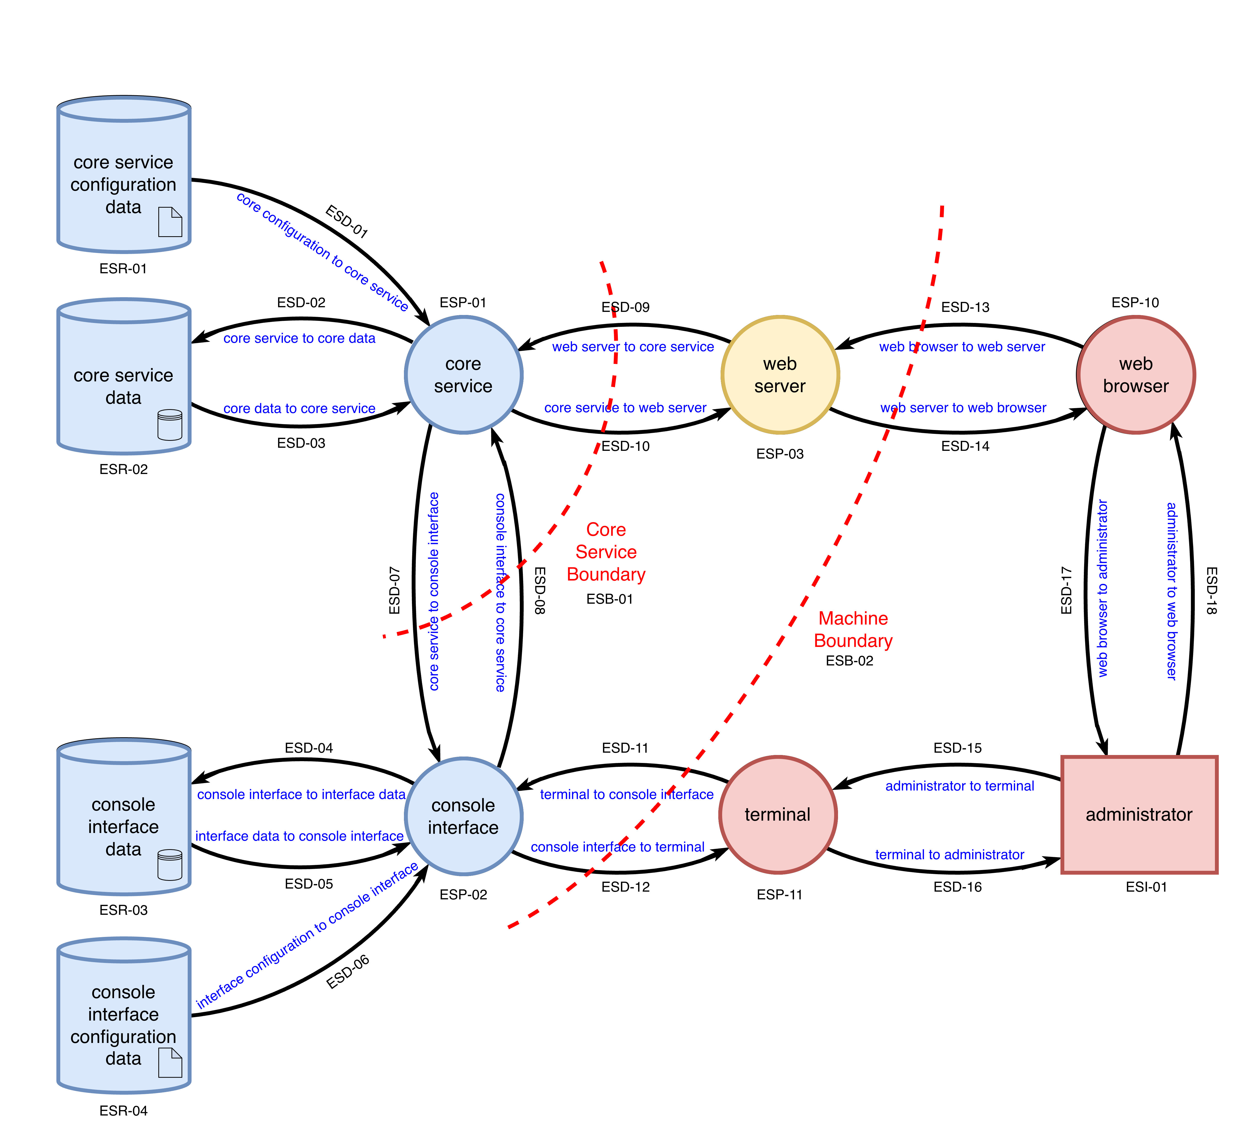
Level 1 DFD
Notes:
Script:
To accomplish the threat modeling activity, the example system was translated into a series of data flow diagrams, DFDs.
[pause]
This is one of them.
What it allows us to do is give detail and context to the data flows, processes, data stores, and boundaries that comprise the system.
The analysis focuses on data transiting trust boundaries,
[pause]
shown here as red dashed lines.
Now let's look at the outcome of the threat model activity, the triage information.

Slide 20
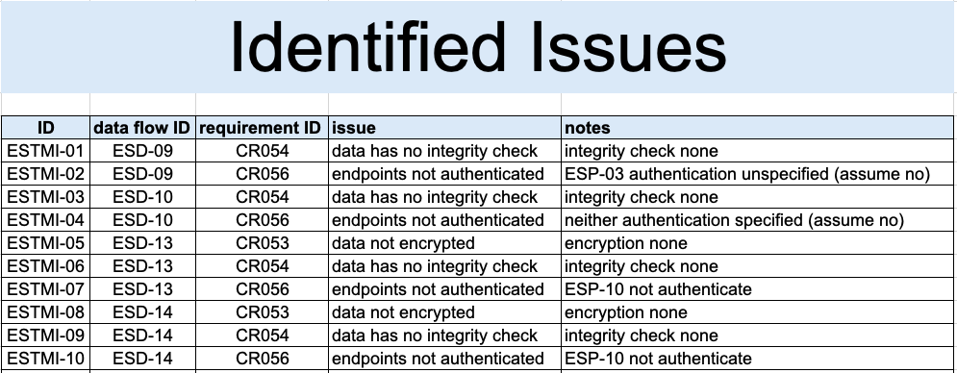
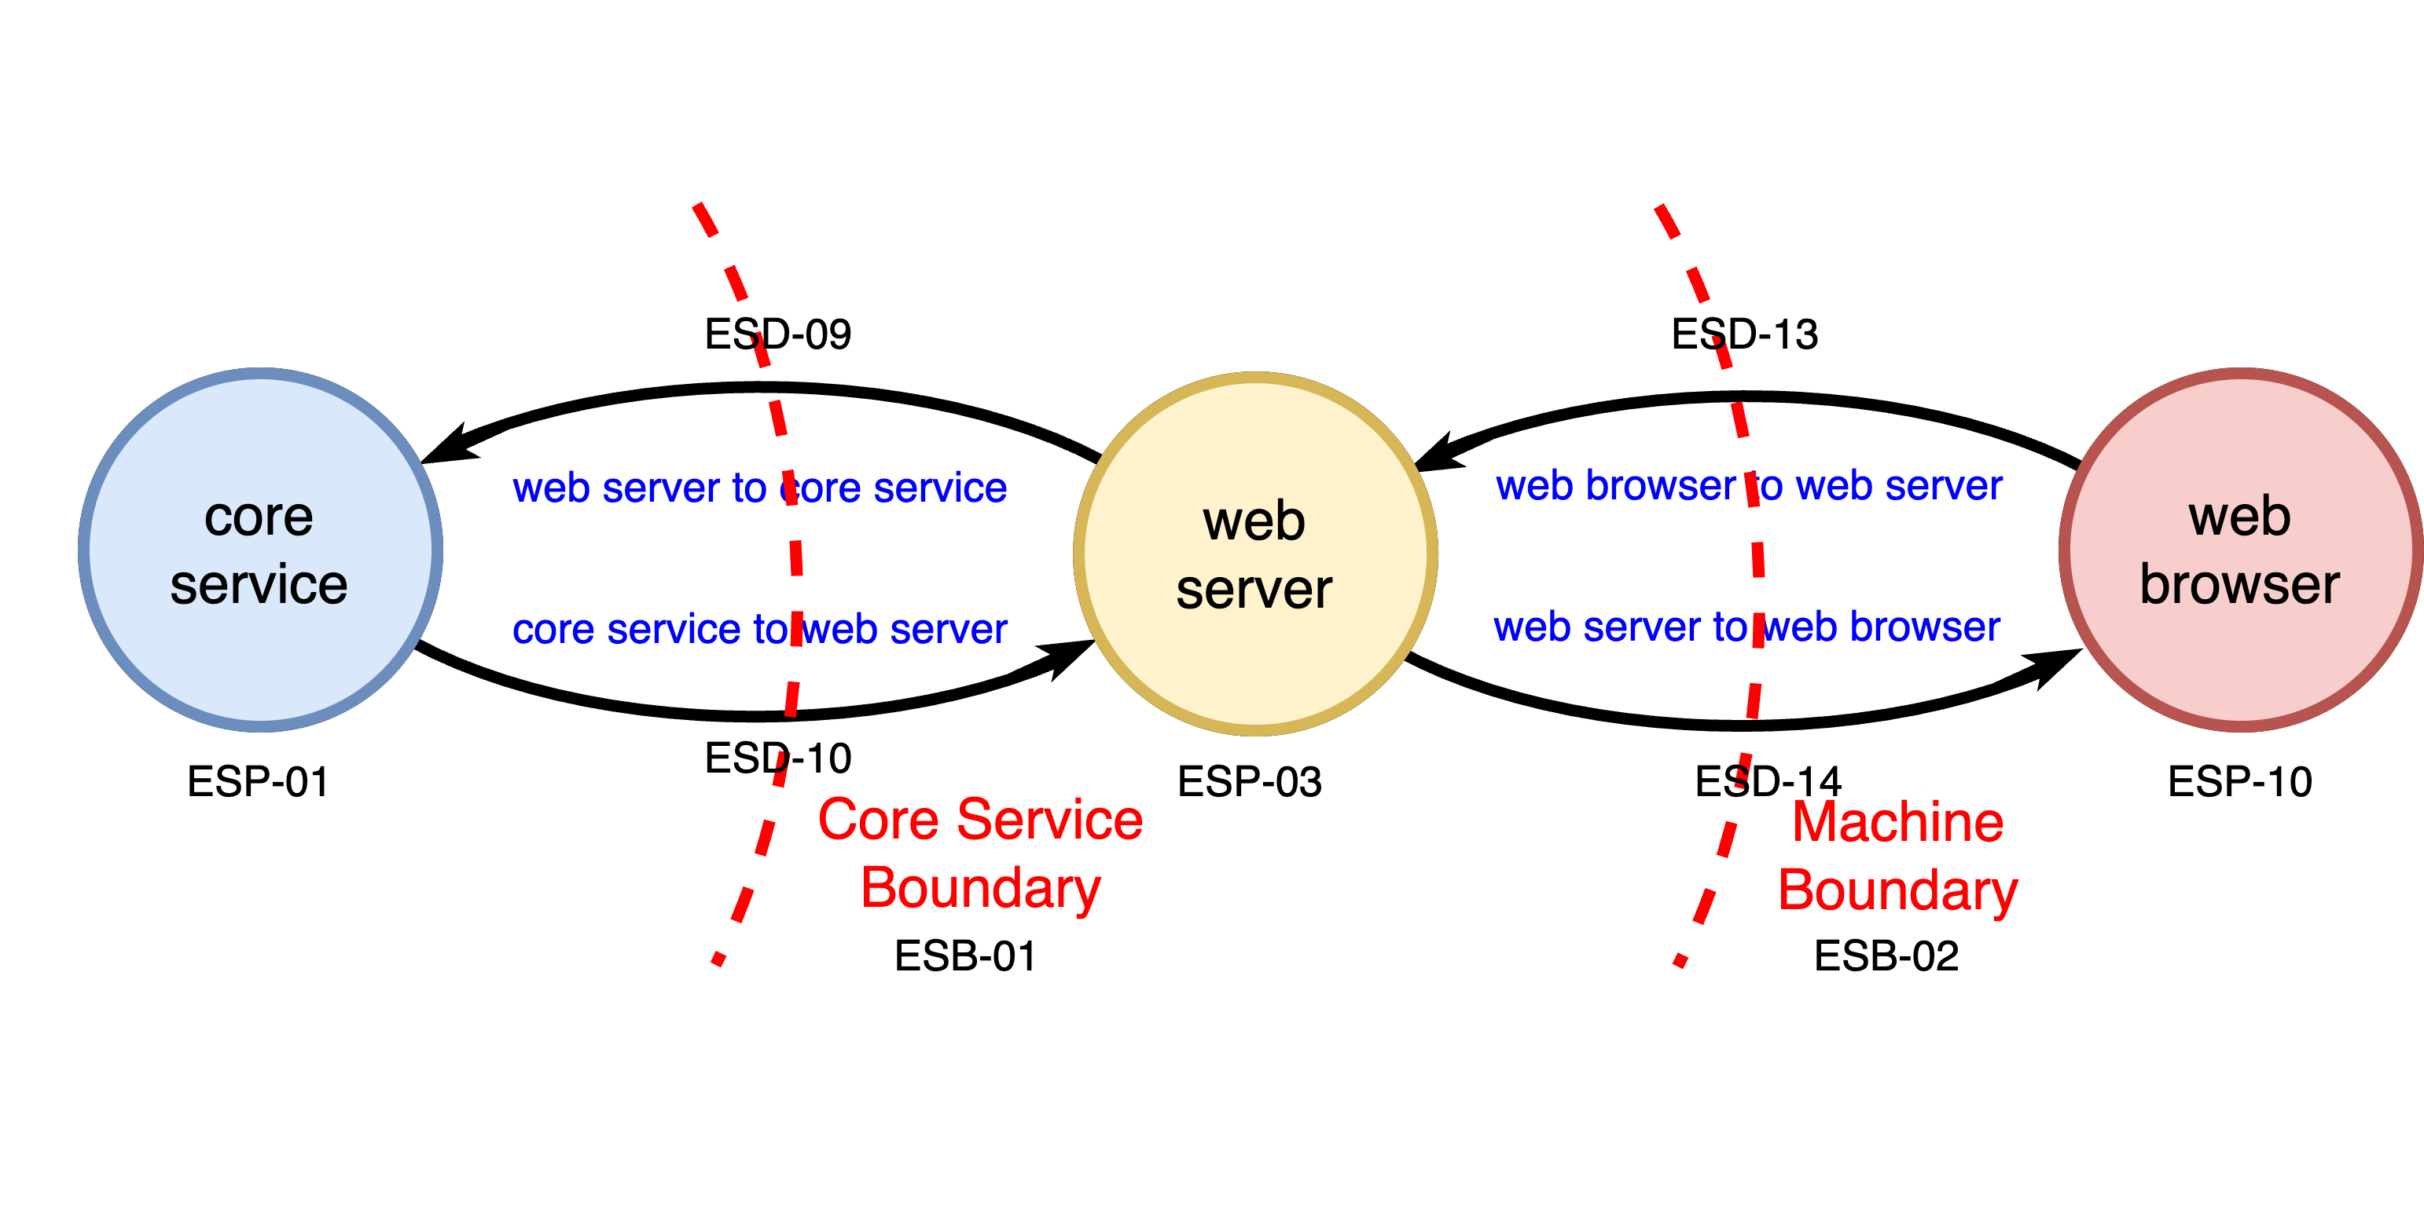
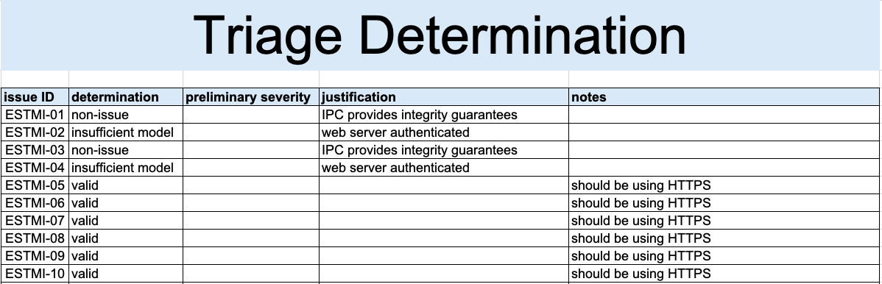
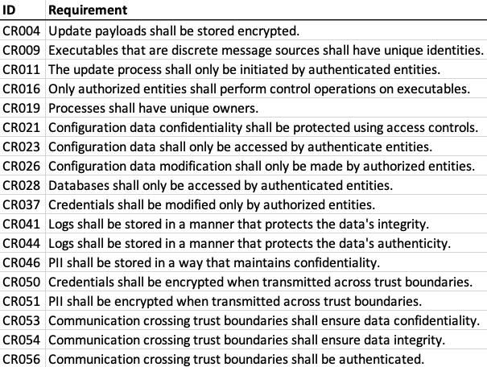
Triage Information
Notes:
Script:
The threat modeling analysis indicated that issues existed around
[pause]
this sub-section of the DFD, involving
[pause]
the core service,
[pause]
the web server, and
[pause]
the web browser,
[pause]
with data flows
[pause]
which cross the machine and core service boundaries.
The analysis generated
[pause]
a set of ten issues, documenting their
• ID
• data flow
• requirement ID
• issue description
and
• notes
Those issues were then
[pause]
triaged.
[pause]
Four of the identified issues were determined to either be non-issues or insufficiencies in the model.
What remained was
[pause]
a set of six issues.
Let’s take these six and rank them using our likelihood rubrics.

Slide 21
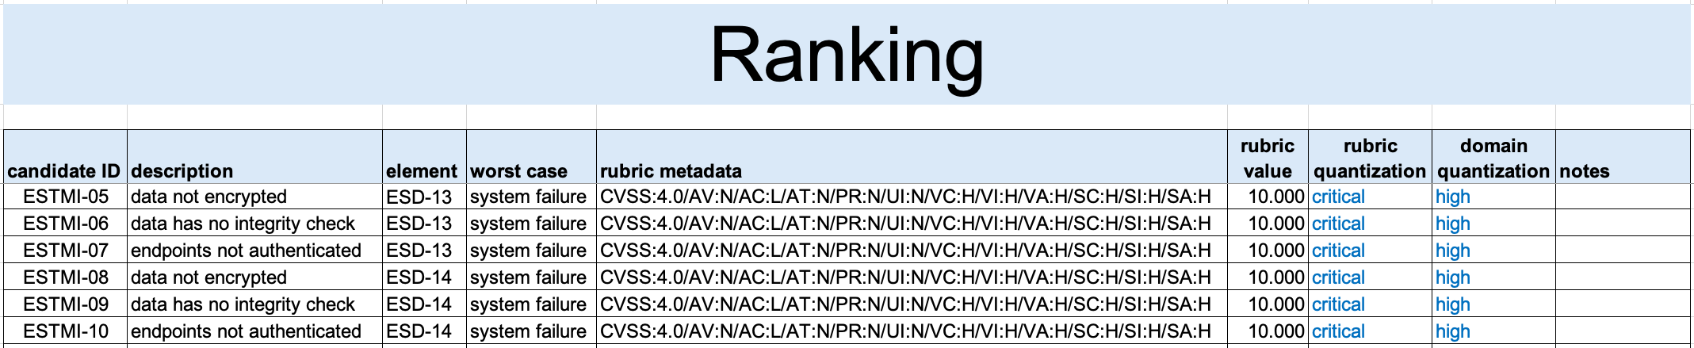
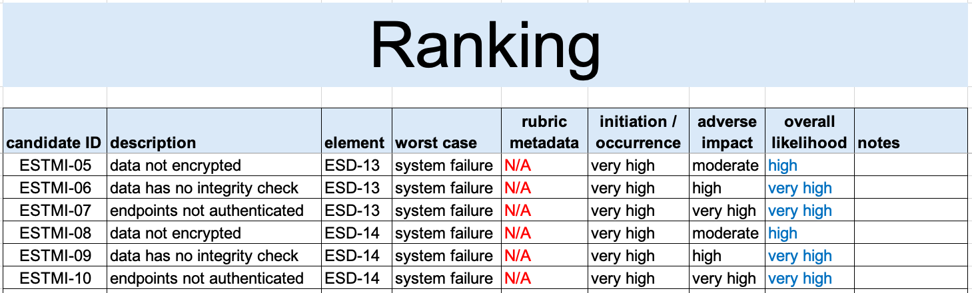
Ranking
CVSS
800-30
Notes:
Script:
Starting with
[pause]
CVSS, we transfer the applicable information from the threat modeling triage activity to the ranking sheet of the workbook.
This includes:
• the threat candidate’s ID
• its description
and
• the element that it's focused on
In this example, the elements we're talking about are
[pause]
two specific data paths, both of which traverse a machine boundary.
Next, we provide
[pause]
a worst case scenario for each threat candidate.
This gives the threat context for the next activity, which is threat candidate risking.
We do this because the element can be fairly deep within the overall system.
Then, for each of the threat candidates, we apply the rubric.
The CVSS rubric asks a series of questions.
The responses to which are encoded as
[pause]
a human-readable metadata string.
This is included for traceability.
It allows others to see exactly what was fed into the rubric.
You can take this string and run it through a CVSS vector decoder to get an explanation of its components.
We then record
[pause]
the value generated by the rubric, which in this case is
[pause]
10.0 for all of the threat candidates.
When this is done, those values are translated by the workbook and populate
[pause]
the quantized value for the rubric and
[pause]
the mapped quantized value for the domain.
In this case the values are
[pause]
critical and
[pause]
high respectively.
Pretty straightforward.
Finally,
[pause]
notes are recorded, when appropriate.
[pause]
Turning now to
[pause]
SP 800-30, we start out transferring
[pause]
the same basic information for the candidate.
[pause]
The worst case scenario is then provided.
[pause]
The rubric metadata is pre-populated to non-applicable and is included in the workbook for consistency.
For this example, we use an adversarial analysis, so here were dealing with
[pause]
the likelihood of initiation.
In all cases the likelihood is
[pause]
very high.
These turn out to be pretty bad issues.
We then determine
[pause]
the likelihood of adverse impact, we can see that it
[pause]
varies widely.
The 800-30 workbook will auto-populate
[pause]
the overall likelihood, which as we see has values of either
[pause]
high or very high.
As with the CVSS workbook,
[pause]
a notes field is provided.
[pause]
Regardless of whether we had used only CVSS with its quantized value of critical and domain quantization of high or 800-30 with its overall likelihood of high and very high, the outcome is pretty much the same.
It's just that with the SP 800-30 we have a bit more nuance.

Slide 22
Recap
Notes:
Script:
That covers the threat prioritization process’ threat candidate ranking activity.
Let's look at a summary.

Slide 23
Summary
Select a likelihood rubric
Set up the quantization mapping
Provide a worst case scenario
Calculate the likelihood
Notes:
Script:
When performing threat candidate ranking,
[pause]
select an appropriate likelihood rubric.
Keep in mind the impact that using more than one rubric within the overall system can have.
[pause]
Next, set up the quantization mapping if that's appropriate.
Unlike with the SP 800-30 template, which provides the necessary mapping, when using CVSS or another numeric-based rubric, you'll need to tailor the template.
If you choose a quantization-based rubric, you can take the 800-30 template and adjust it accordingly.
[pause]
Next, provide a worst case scenario.
This greatly simplifies the work that has to be done downstream of the ranking activity.
[pause]
Finally, calculate the likelihood.
Assuming you've done the setup for the quantization, the quantized values will take care of themselves.

Slide 24
Example Materials
<AVCDL>/source/reference_documents/working_material/example system/
Notes:
Script:
The materials used to cover this example are in the location shown here.
It's important to note that this includes the two ranking workbooks, as well as all of the threat modeling materials referenced.

Slide 25
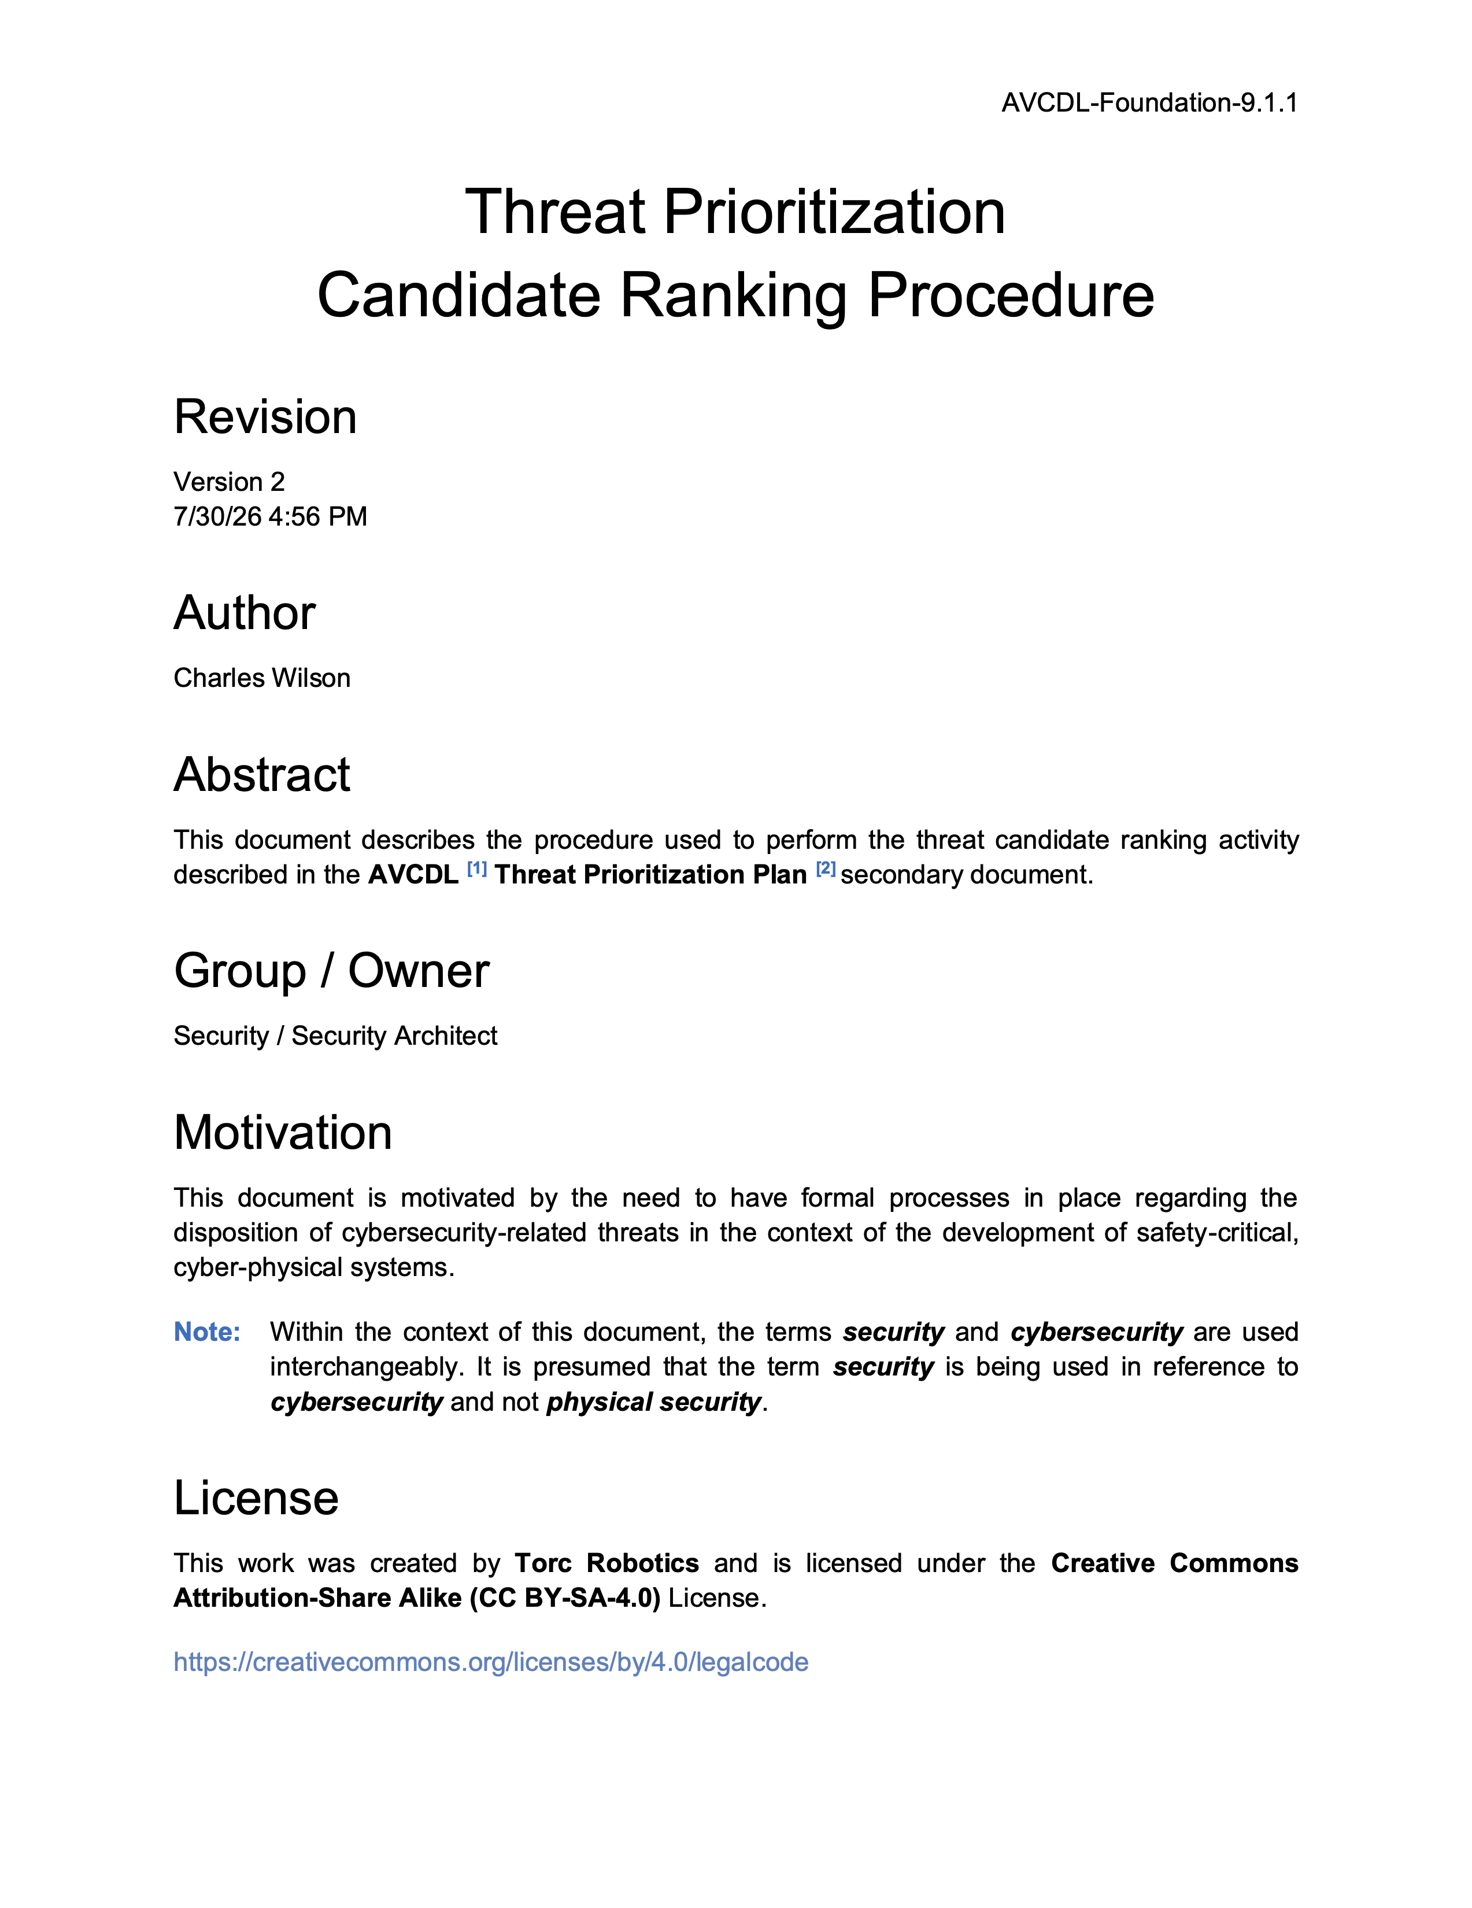
Further Reading
Notes:
Script:
For additional information and to get a more in-depth set of references, the Threat Prioritization – Candidate Ranking Procedure tertiary document is available in the AVCDL GitHub repository.

Slide 26
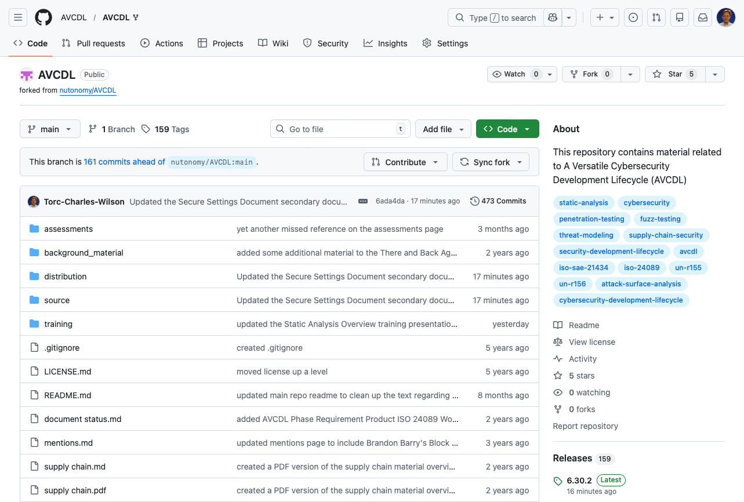
AVCDL on GitHub
https://github.com/AVCDL/AVCDL
Notes:
Script:
All AVCDL materials, both in source and distribution forms, are available on our GitHub site, as shown here.
Because of the size of the repository, it's recommended that you either clone the repository or download a ZIP archive of it, if you're not familiar with using git.
Instructions for downloading a ZIP archive are linked to on the repository’s front page.

Slide 27
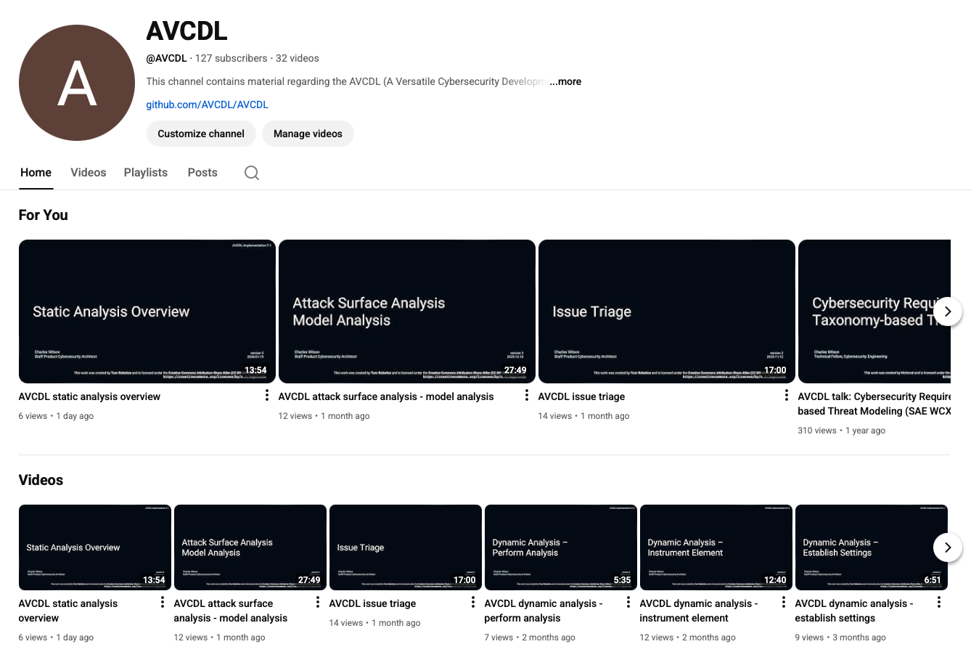
AVCDL on YouTube
https://youtube.com/@AVCDL
Notes:
Script:
Videos covering various aspects of the AVCDL are available on our YouTube channel, as shown here.
It's important to note that all AVCDL materials with the exception of the introductory blog posts are intended for product cybersecurity engineering practitioners.

Slide 28
Next Steps
Notes:
Script:
With this training complete, if you’ve completed the other trainings covering the Threat Prioritization process activities, you can proceed to
Attack surface analysis
Threat modeling
Penetration testing
and
Vulnerability identification
Additionally, if you’ve completed Secure Coding and it’s prerequisites, you can proceed to
Static analysis
Dynamic analysis
Fuzz testing
and
Secure code review

Slide 29
References
AVCDL (AVCDL primary document)
Threat Prioritization Plan (AVCDL secondary document)
AVCDL threat candidate ranking template (AVCDL template)
AVCDL threat candidate ranking (SP 800-30) template (AVCDL template)
Common Vulnerability Scoring System
https://www.first.org/cvss/
The Common Configuration Scoring System (CCSS): Metrics for Software Security Configuration Vulnerabilities https://nvlpubs.nist.gov/nistpubs/legacy/ir/nistir7502.pdf
The Common Misuse Scoring System (CMSS): Metrics for Software Feature Misuse Vulnerabilities
https://tsapps.nist.gov/publication/get_pdf.cfm?pub_id=910230
ISO/SAE 21434:2021 Road vehicles – Cybersecurity engineering https://www.iso.org/standard/70918.html
NIST SP 800-30 r1 - Guide for Conducting Risk Assessments
https://nvlpubs.nist.gov/nistpubs/Legacy/SP/nistspecialpublication800-30r1.pdf
Notes:
Script:
Here are references to the source material used in the creation of this presentation.
They'll also be included in the video description.
Additionally, this presentation’s source material will be provided on the AVCDL GitHub repository.

